Slide 1
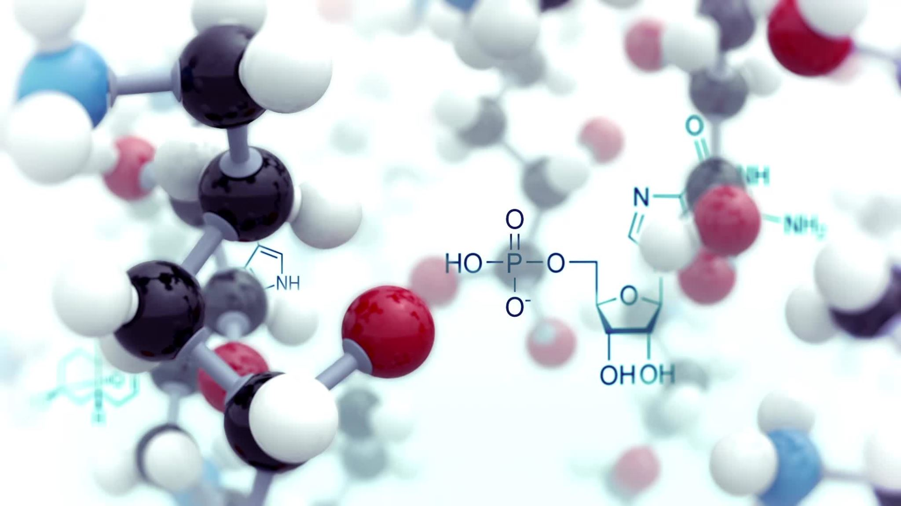
Anatomy of Incident Response and Root Cause Analysis

Slide 2
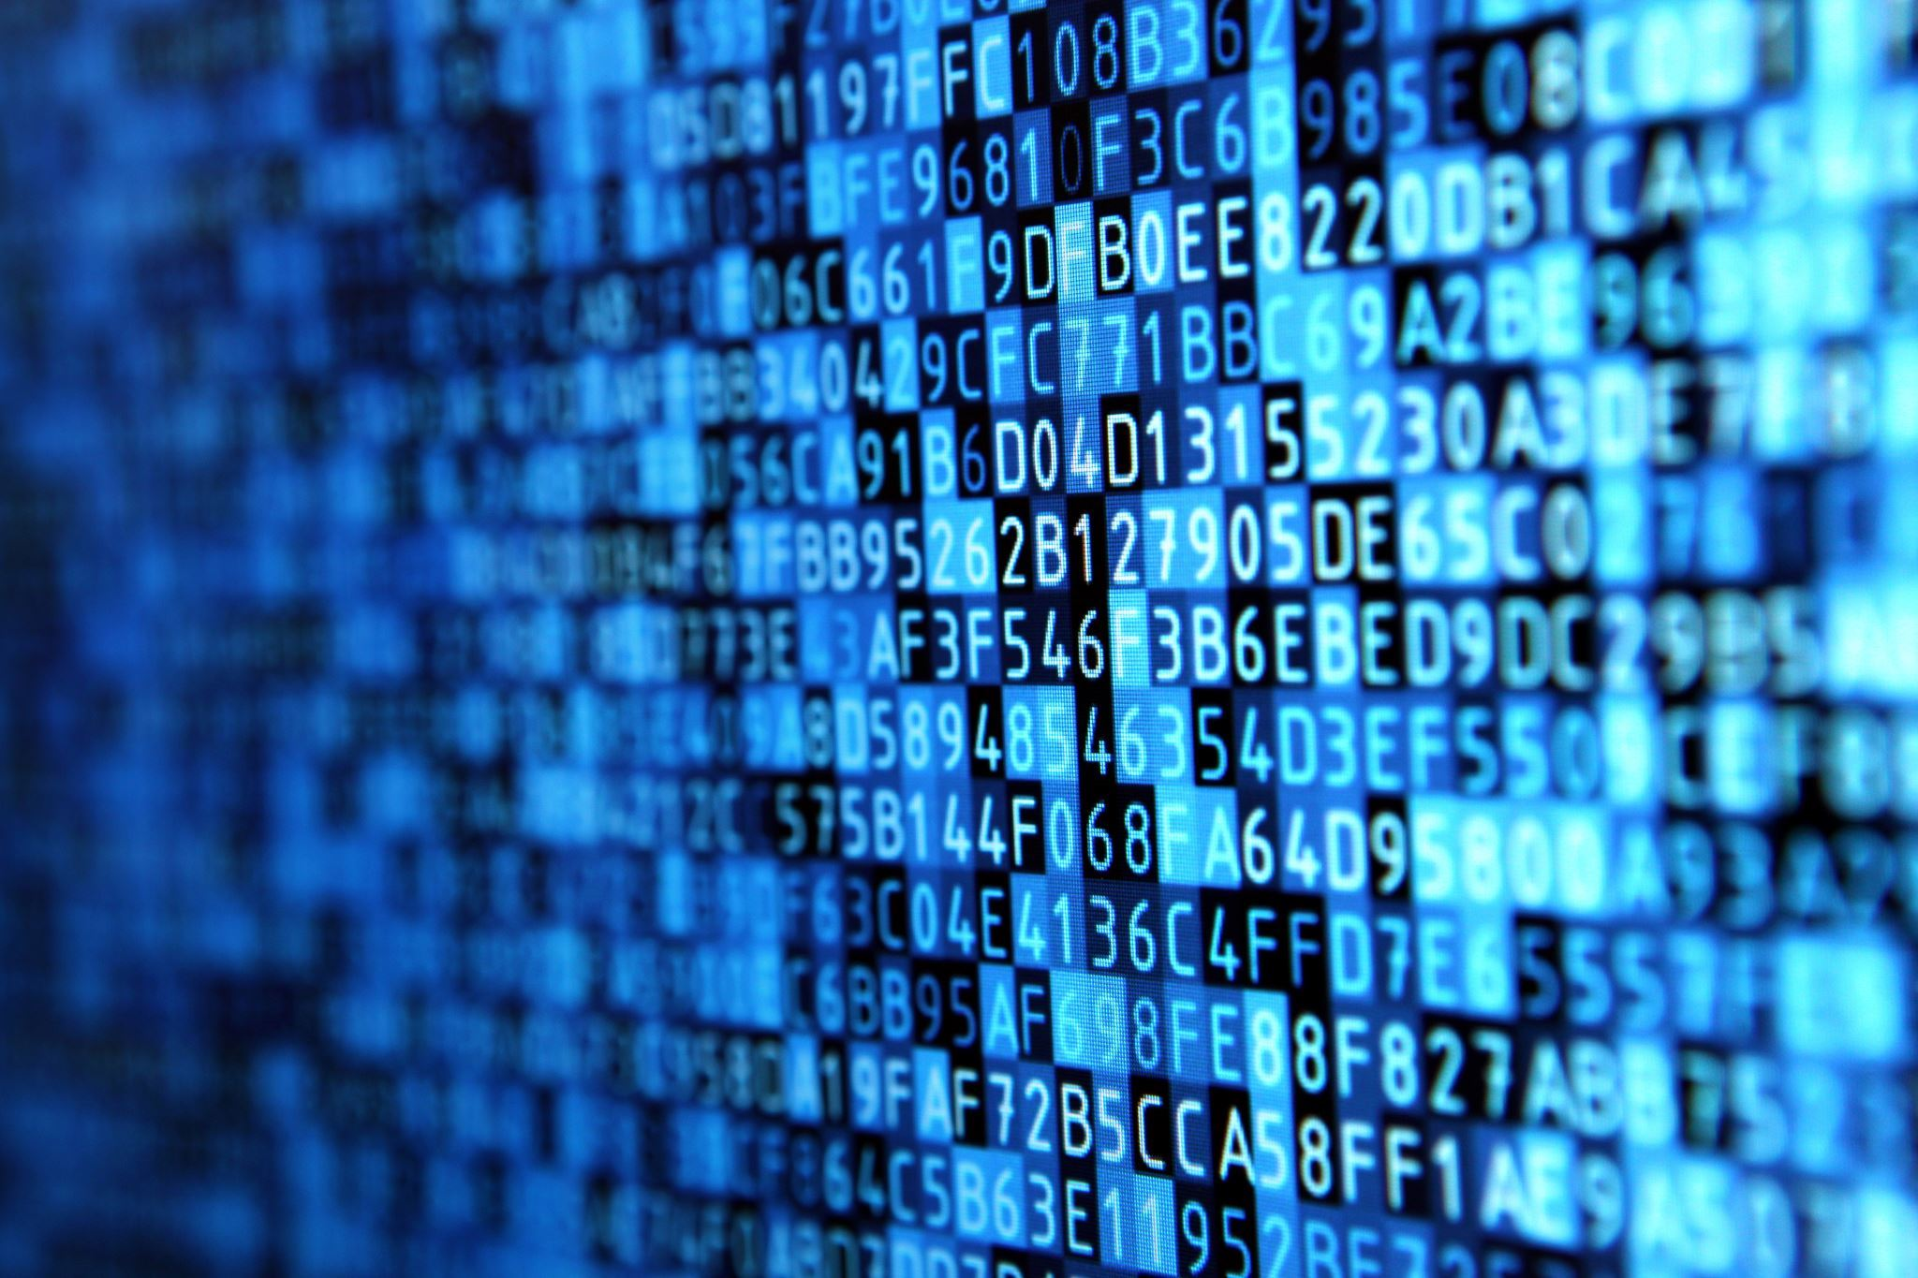
What Is Digital Forensics?
Digital forensics is the collection, assessment and presentation of evidence gathered from digital media. Digital evidence comes from computers, mobile phones and servers. Digital forensics helps solve complicated cases that rely on evidence from electronic devices.

Slide 3

Steps in performing digital forensics
9)Expert Witness Testimony
1)First Response. ...
2)Search and Seizure. ...
3)Evidence Collection. ...
4)Securing of the Evidence. ...
5)Data Acquisition. ...
6)Data Analysis. ...
7)Evidence Assessment. ...
8)Documentation and Reporting.
(University of Nevada, Reno, 2022)

Slide 4

Steps in performing digital forensics from the initial recognition of an incident through the steps of evidence gathering
Identification of resources and devices involved in the investigation
Preservation of the necessary data
Analysis
Documentation
Presentation
(ERMProtect Staff, 2022)

Slide 5
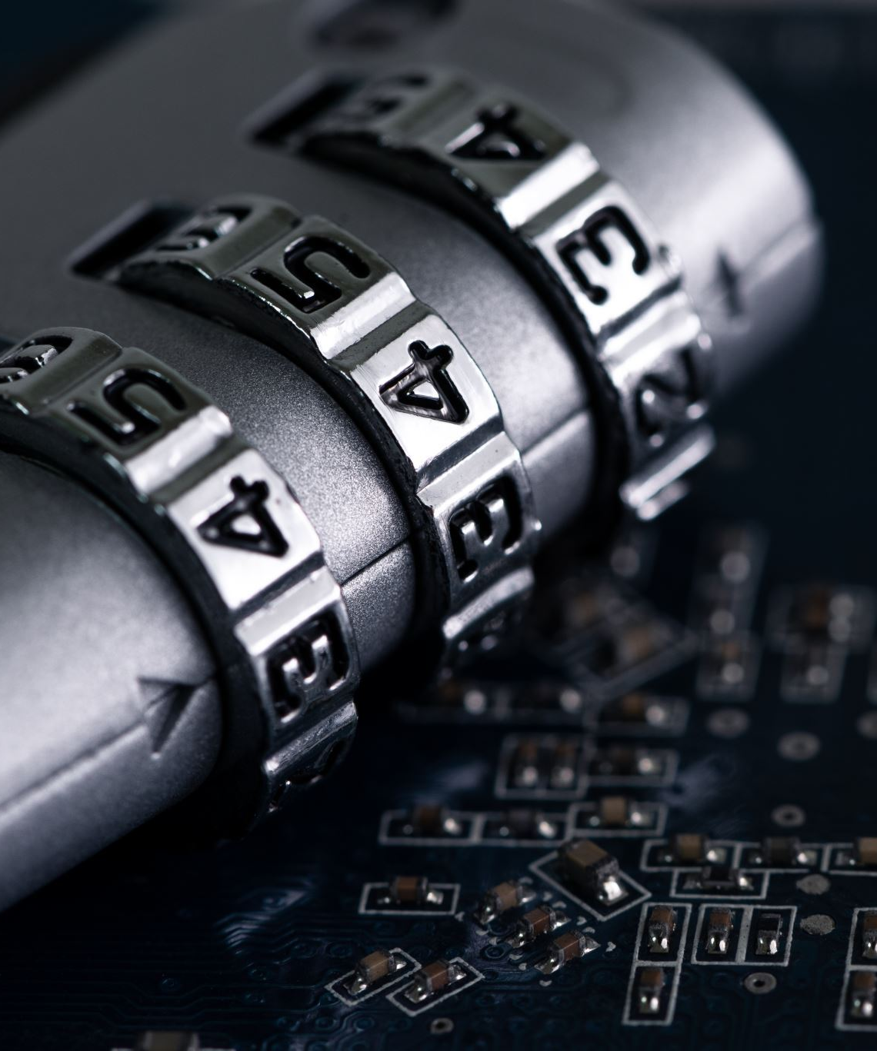
Preservation and analysis
The most effective methods to ensure legal admissibility while preparing to engage a forensic analyst to include the following:
Drive Imaging
Hash Values
Chain of Custody
(Simon, n/a)

Slide 6

Preservation – the process of preserving relevant electronically stored information (ESI) by protecting the crime or incident scene, capturing visual images of the scene and documenting all relevant information about the evidence and how it was acquired.

Slide 7

Procedural cybercrime laws (e.g., authority to preserve and obtain electronic data from third parties, including internet service providers; authority to intercept electronic communications; authority to search and seize electronic evidence):
18 U.S.C. §§ 2510-2522 – Interception of wire, oral, or electronic communication
18 U.S.C. §§ 2701-2712 – Preservation and disclosure of stored wire and electronic communication
18 U.S.C. §§ 3121-3127 – Pen registers and trap and trace devices
(oas.org, 2006)

Slide 8

Digital media seized for investigation is usually referred to as an "exhibit" in legal terminology. Investigators employ the scientific method to recover digital evidence to support or disprove a hypothesis, either for a court of law or in civil proceedings.

Slide 9
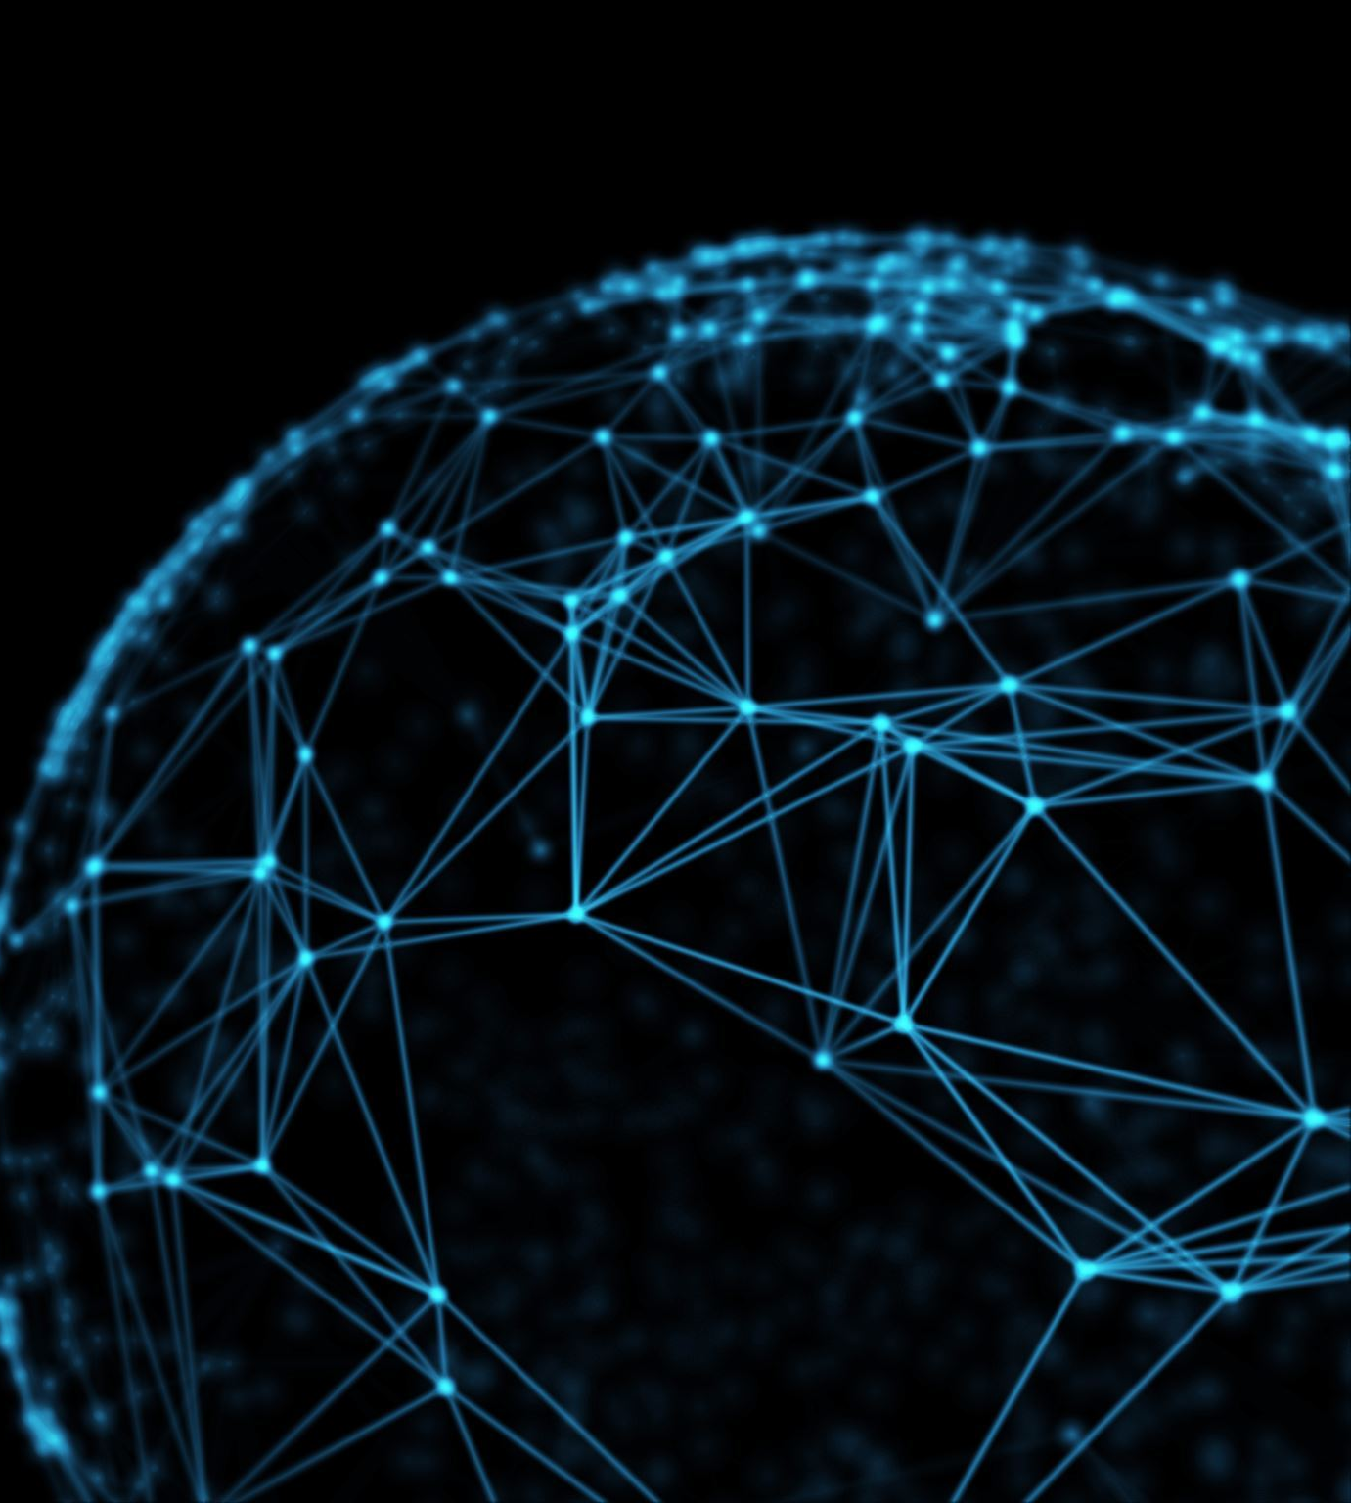
Root causes can be divided into three types
Physical - when a physical part of a system breaks down. These include hardware failures, system errors from booting up, issues with tools not functioning, or other tangible components breaking down.
Human - arise from human errors or mistakes. If a person does not have the necessary skills to operate systems properly, does not know the tools, creates a programming error, or tries to perform tasks with incorrect tools.
Organizational - arise from administrative issues. For example, suppose a team lead provides incorrect instructions to team members. In that case, organizations make the incorrect selection of people to perform tasks, or the organization does not handle or maintain staff correctly.
(Logic, n/a)

Slide 10

Take Actions
But if you have no idea where to start, try using some of the common tools listed below:
Interviewing – subject matter experts or industry experts
Running diagnostic Tools when the root cause is found
Checking forums and messaging boards for common solutions to known problems
(RSI Security, 2021)

Slide 11

Root cause analysis helps government agencies determine the underlying issues that led to an incident, cybersecurity or otherwise, and aids in preventing repeats.

Slide 12

Whenever possible, do not examine the original media. Write protect the original, copy it, and examine only the copy. Use write blocking technology to preserve the original while it is being copied. Computer forensic examiners must meet minimum proficiency standards.

Slide 13

The main goal of digital forensics is to extract data from the electronic evidence, process it into actionable intelligence and present the findings for prosecution. All processes utilize sound forensic techniques to ensure the findings are admissible in court.

Slide 14
References
Cybercrime Laws of the United States. (2006, October). Cybercrime laws of the United States - oas.org. Retrieved April 30, 2023, from https://www.oas.org/juridico/spanish/cyber/us_cyb_laws.pdf
ERMProtect Staff. (2022, August 26). What are the 5 stages of a digital forensics investigation? - cybersecurity: Digital Forensics: Crypto Investigations. ERMProtect. Retrieved April 29, 2023, from https://ermprotect.com/blog/what-are-the-5-stages-of-a-digital-forensics-investigation/
Logic, S. (n.d.). Root cause analysis - definition & overview. Sumo Logic. Retrieved April 29, 2023, from https://www.sumologic.com/glossary/root-cause-analysis/#:~:text=hosts%2C%20and%20Kubernetes.-,What%20are%20the%20types%20of%20root%20causes%3F,cyber%20security%20incident%20response%20process.
RSI Security. (2021, March 30). Six steps to effective root cause analysis. RSI Security. Retrieved April 29, 2023, from https://blog.rsisecurity.com/six-steps-to-effective-root-cause-analysis/
Simon, M. (n.d.). 3 methods to preserve digital evidence for computer forensics: Critical insight. 3 Methods to Preserve Digital Evidence for Computer Forensics | Critical Insight. Retrieved April 29, 2023, from https://www.criticalinsight.com/resources/news/article/3-methods-to-preserve-digital-evidence-for-computer-forensics
University of Nevada. (2022, July 14). The phases of Digital Forensics. University of Nevada, Reno. Retrieved April 29, 2023, from https://onlinedegrees.unr.edu/blog/digital-forensics/

